Slide 1



Tomographic Reconstruction of Density Gradients Created by a Plasma Actuator
Sydney Bayliff
Dr. James Threadgill and Ashish Singh, University of Arizona
Arizona NASA Space Grant Symposium
April 18th, 2026

Slide 2
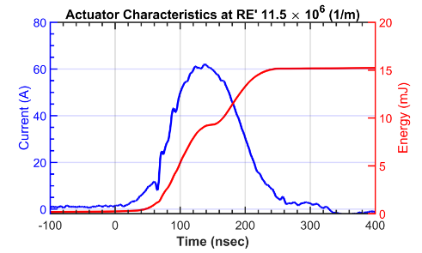
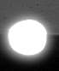


What is Plasma?
Plasma
Localized Arc Filament Plasma Actuator (LAFPA)
Superheated, ionized gas with electrodes ripped apart from the atoms
Interacts with magnetic and electric fields
Plasma fields vary in time and in space
High voltage pulses sent between electrodes creating localized discharge
Active flow control in high-speed flows to combat boundary layer instabilities
Current (A)
Energy (mJ)
Time (nsec)
Copyright 2023 by AIAA. *for full citation see Note
Notes:
Note: From Schlieren Visualization of Controlled Disturbances in Mach 5 Flow Over a Hollow Cylinder Flare, by A. Singh, C. Hader, J. A. Threadgill, H. F. Fasel, & J. C. Little, 2023, AIAA SCITECH 2023 Forum (AIAA 2023-0681). Copyright 2023 by AIAA.

Slide 3
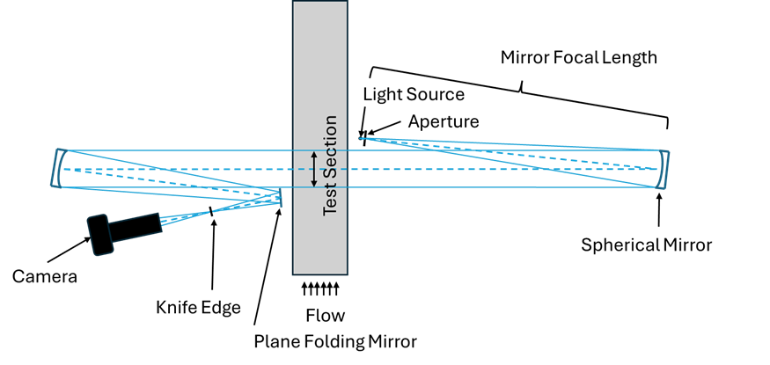
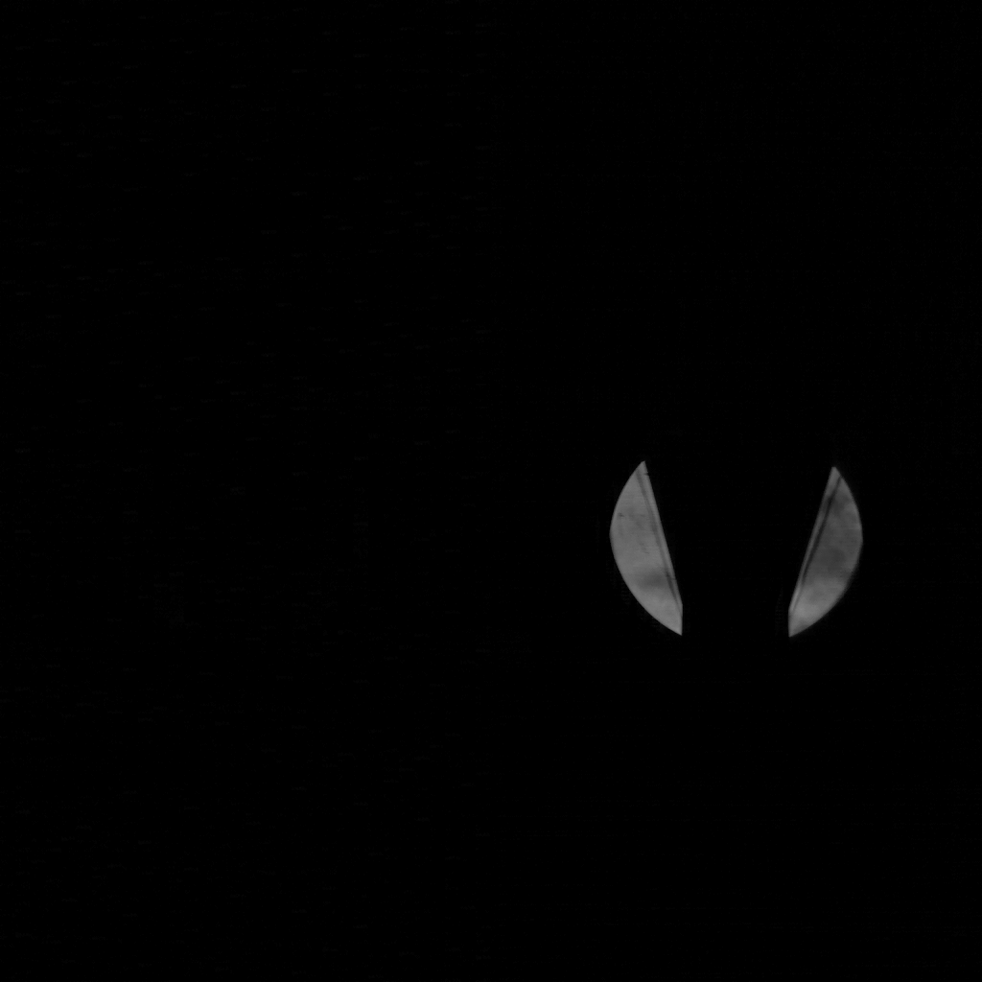
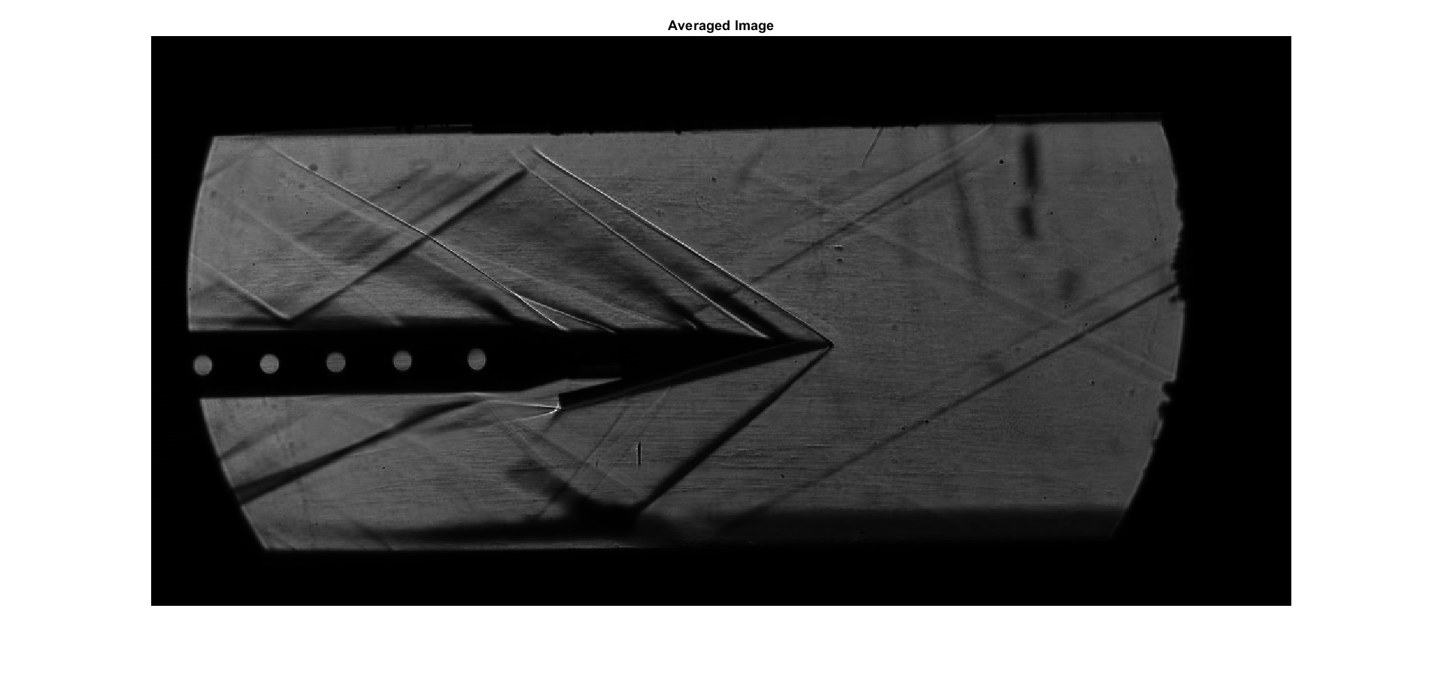
Schlieren Imaging
Measures density gradients by visualizing changes in the refractive index of air as a light source travels through the test section
Can lead to characterization of flow structures otherwise invisible, such as shock waves
Sample Schlieren photos

Slide 4
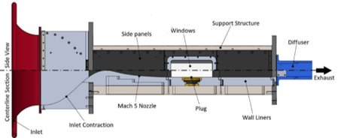
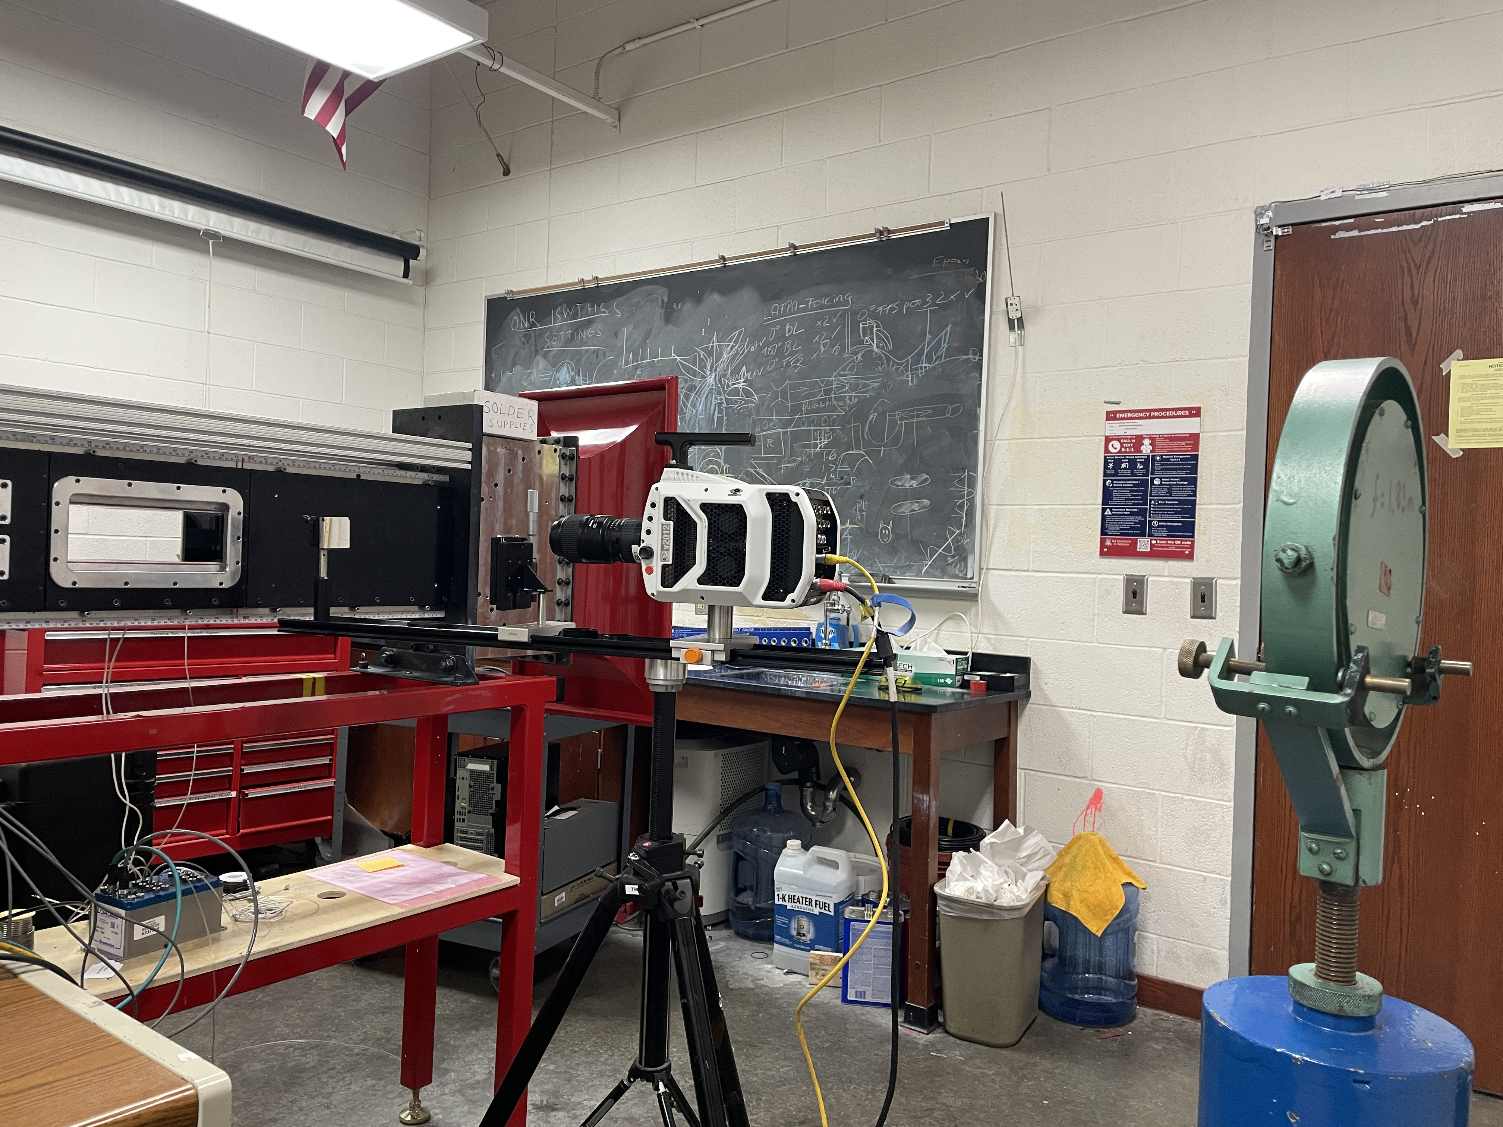
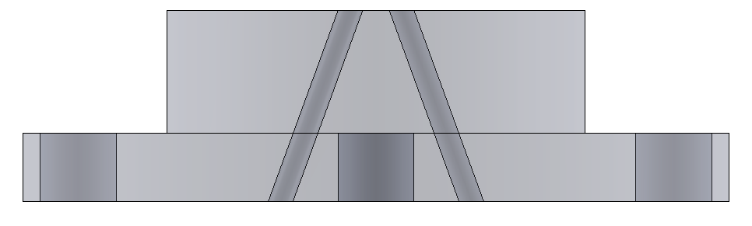
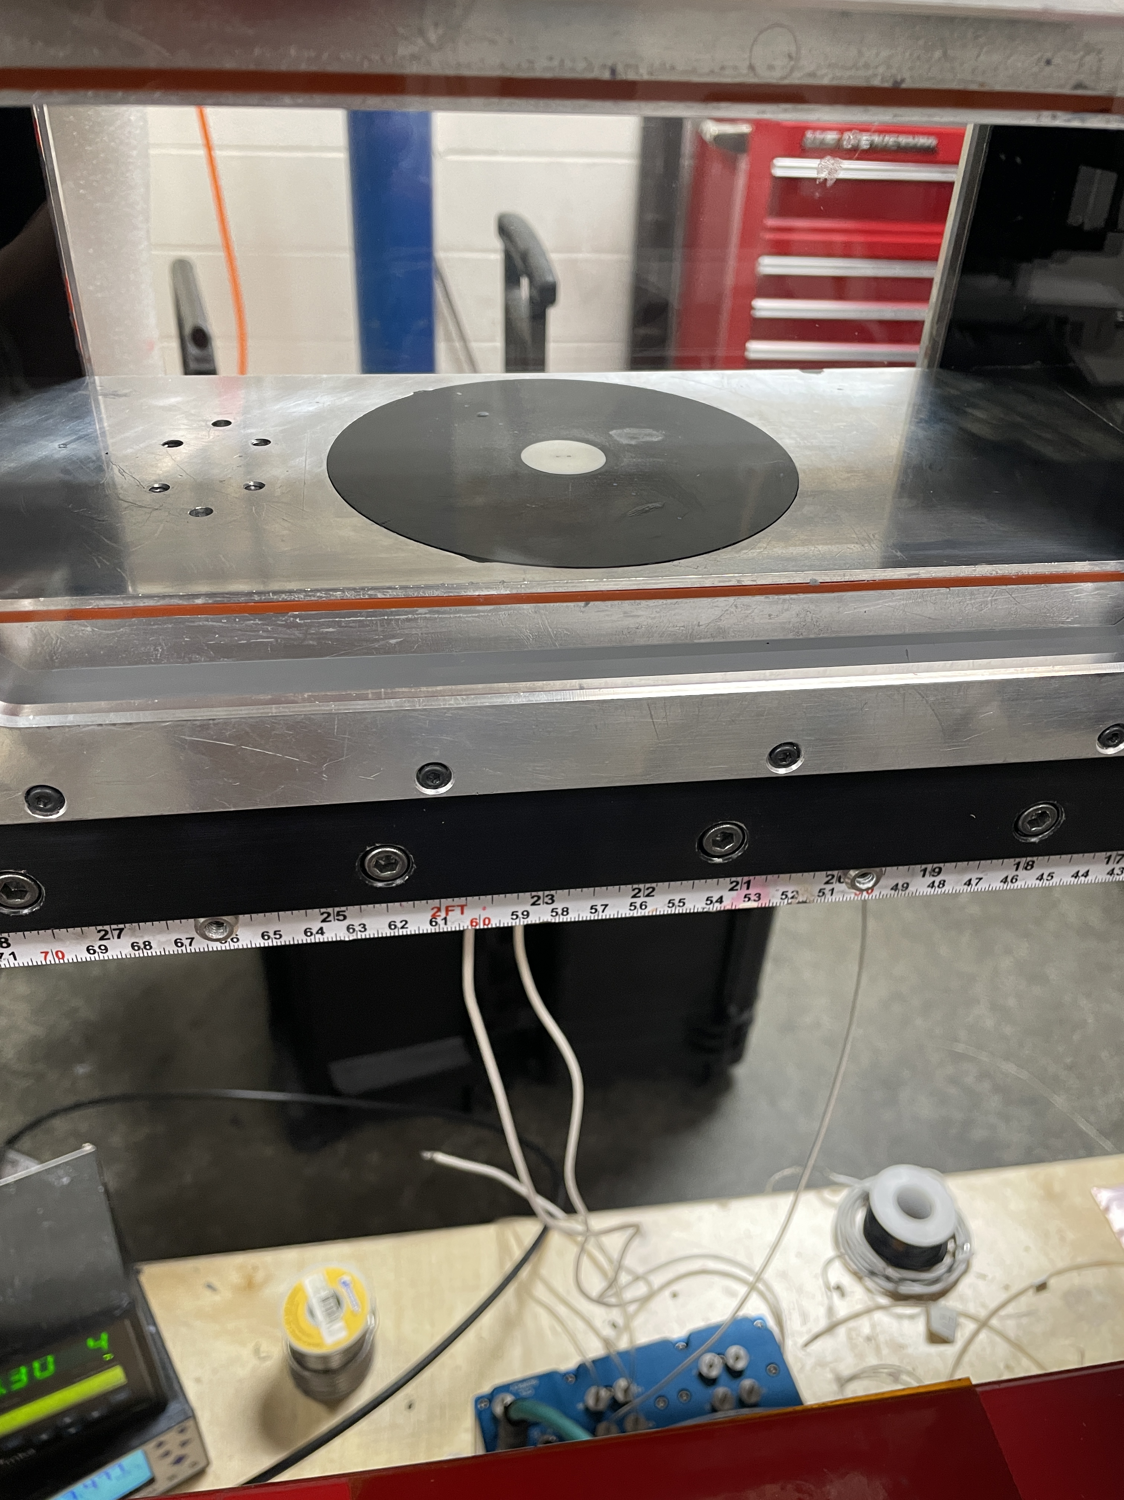
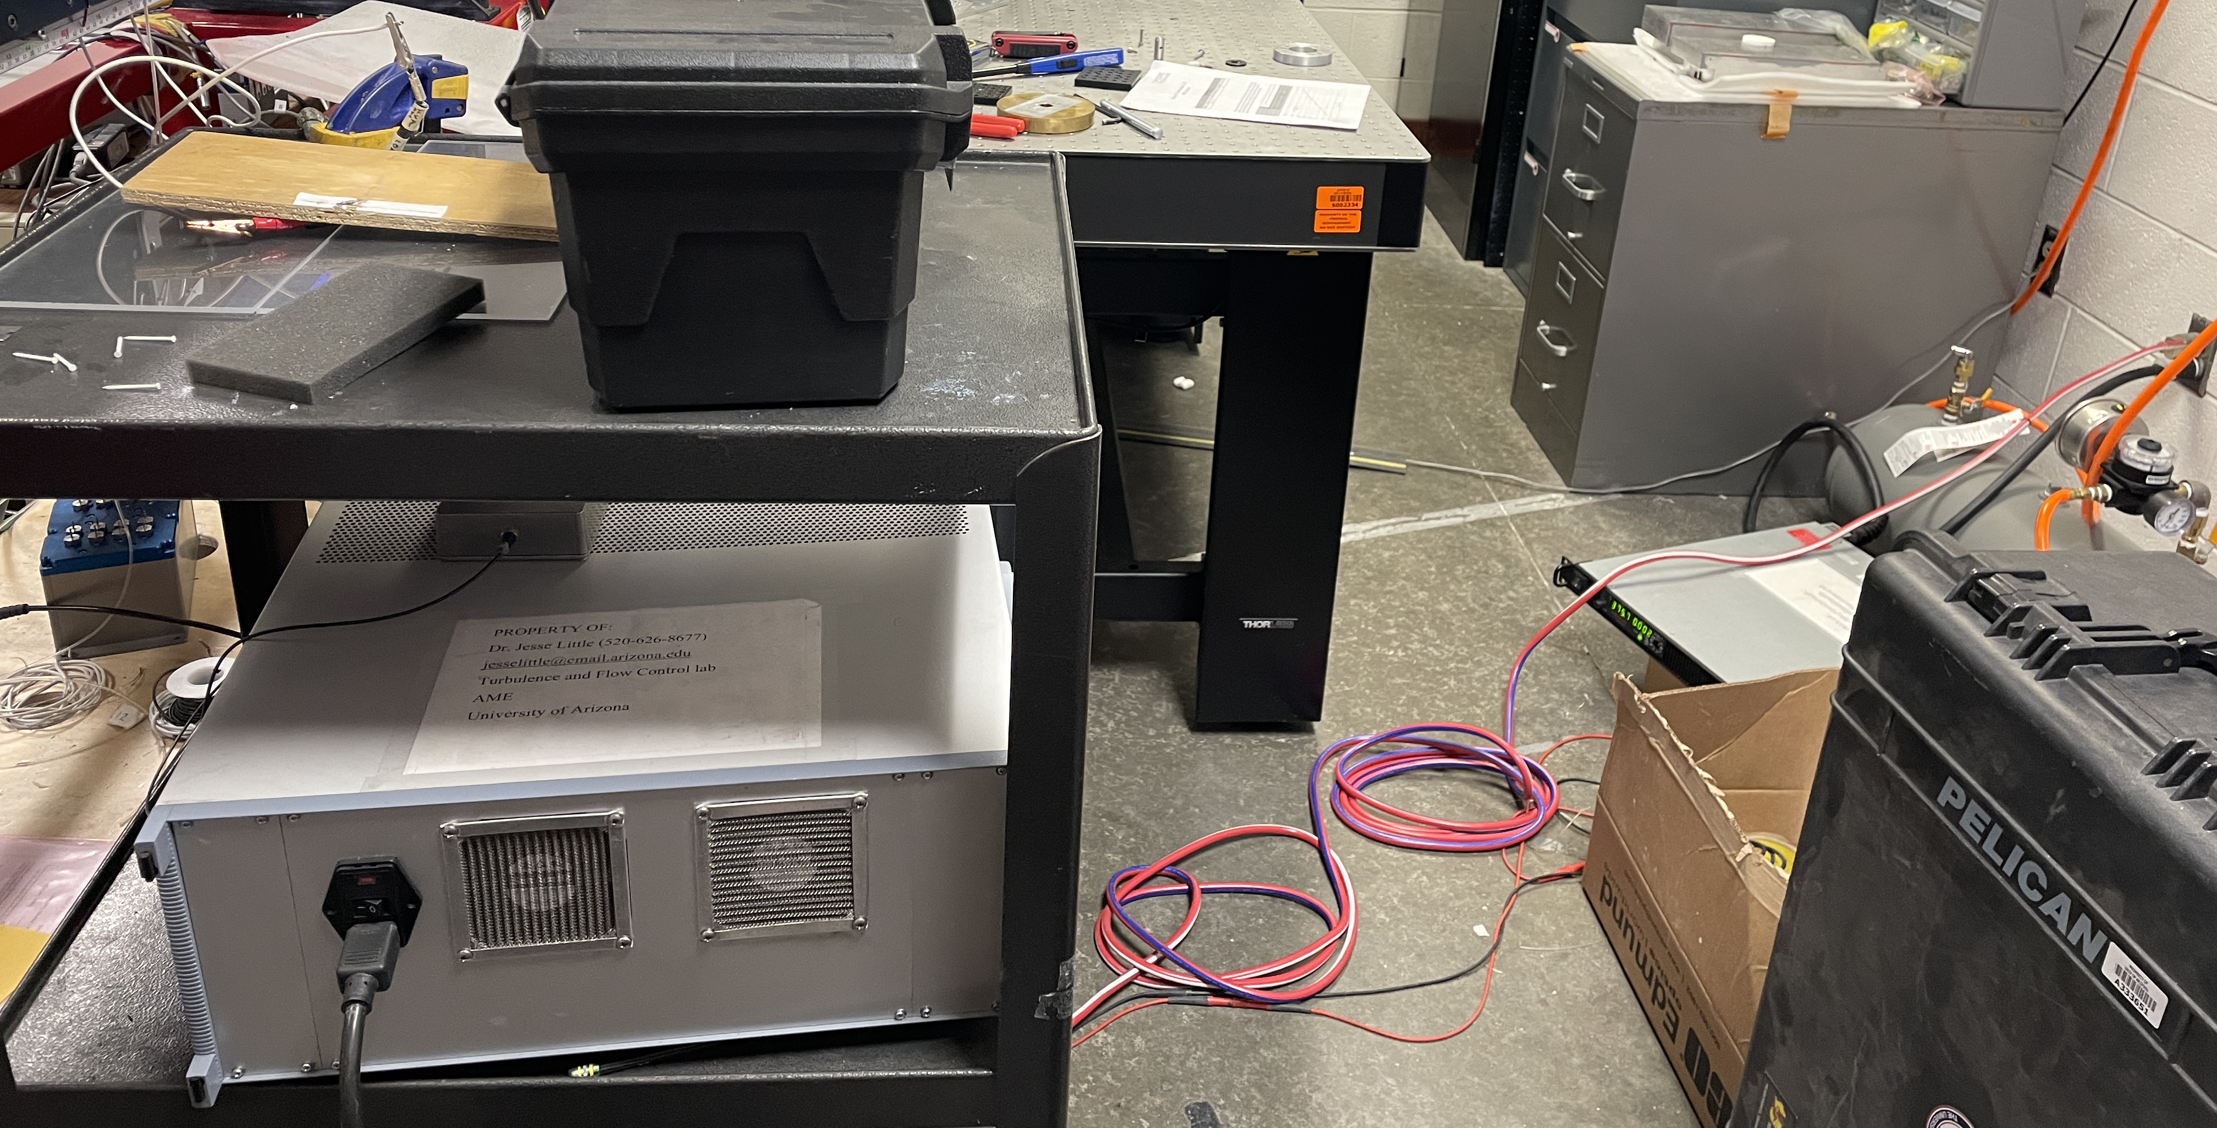
Experimental Set Up
202407 ISWT Data Sheet 1 [Data Sheet]. University of Arizona​
Schlieren set up
Side Panels
Support Structure
Indraft Supersonic Wind Tunnel (ISWT) at UA;
Flow off → pressure vessel
Windows
Diffuser
Exhaust
Mach 5 Nozzle
Inlet Contraction
Wall Liners
Inlet
Plug
Electrode ports
Rotating plug allowing for multiple viewing angles
Plasma generator:
Sending a voltage of 375V at 2kHz
Rotation angles: 0° - 180°, increments of 5°

Slide 5
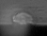
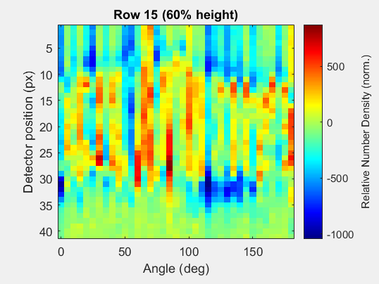
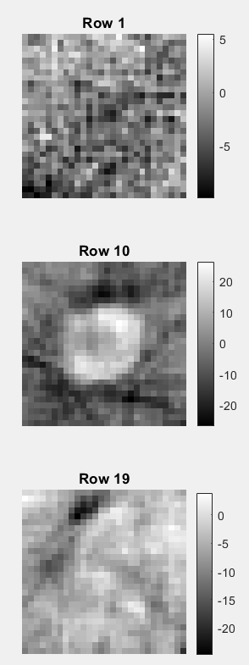
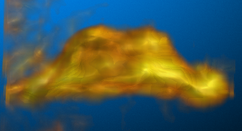
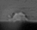
Tomographic Reconstruction
Reconstructs volumetric 3D fields from 2D images to allow for characterization of complex flow fields
1. Schlieren at multiple viewing angles
2. Sinograms from projection data
3. Inverse Radon transform
4. Stack 2D slices
90°
Positive: high density plasma
Negative: evacuated gas
180°

Slide 6

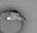
1. Image Phase Averaging
Average across all frames corresponding to the same plasma field structure
  200 pulses were averaged
120,000 fps with a 2 kHz signal to the plasma generator → 60 frames per cycle
  Frame 36 is of interest
Phase averaging step included:
  Background subtraction
  Centering plasma field
  Performing axis rotation
45° case - All frames
45° case – Averaged Frame 36
Artefact from discharge glow

Slide 7
2. Sinogram
Row 15 (60% height)
Represents a spatial map of the line-of-sight integrated density
Row #: image pixel height
Detector position: image pixel width
Positive value: high density plasma region
Negative value: evacuated gas
Detector position (px)
Relative Number Density (norm.)
Angle (deg)
60%-pixel height

Slide 8
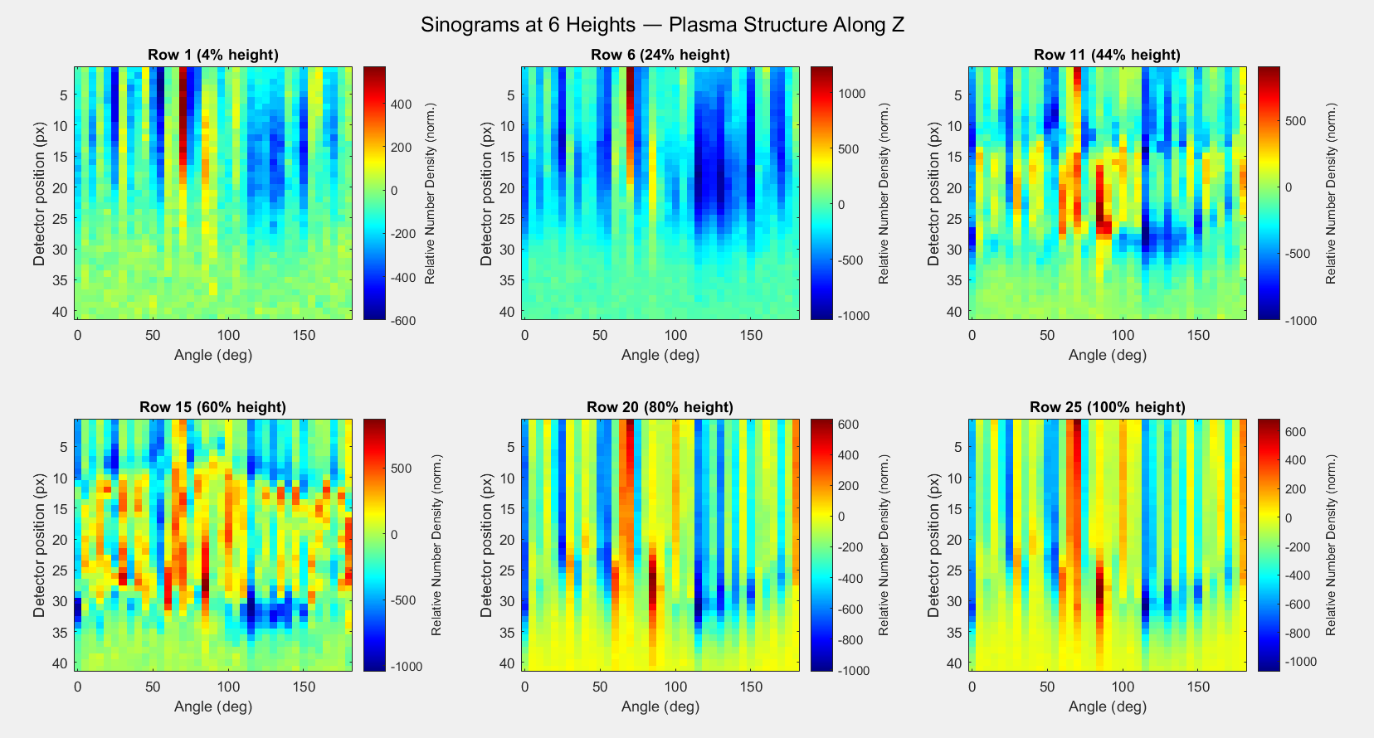
Z-Height: Image Pixel 1
Z-Height: Image Pixel 11
Z-Height: Image Pixel 6
Z-Height: Image Pixel 15
Z-Height: Image Pixel 20
Z-Height: Image Pixel 25

Slide 9
3. Reconstructed 2D Slices
Inverse Radon Transform
Uses parallel-beam geometry and filtered back projection to reconstruct the 2D cross-section of the density field at each vertical slice.
Increase accuracy with more viewing angles

Slide 10
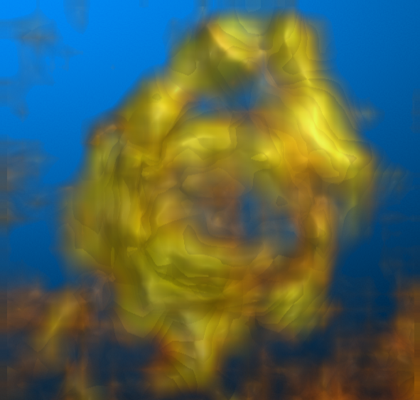
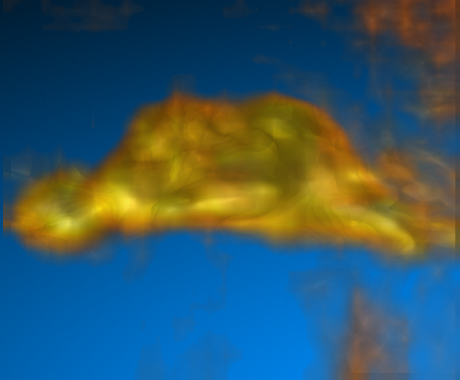
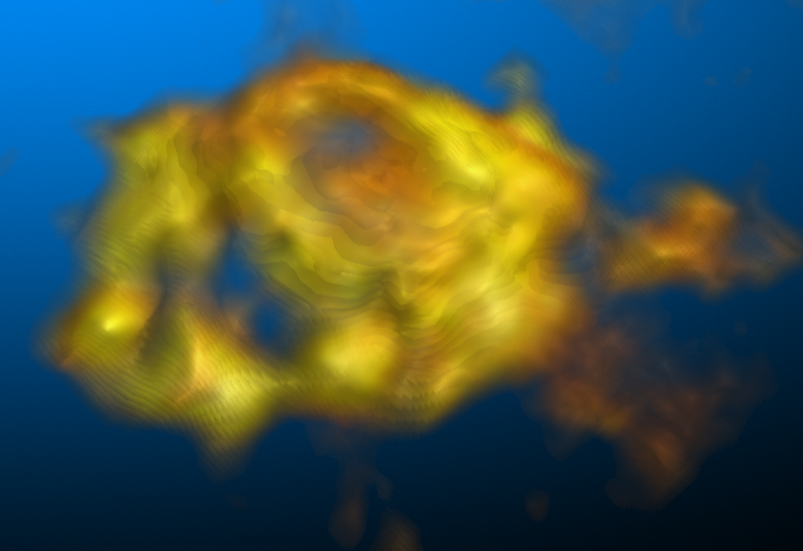
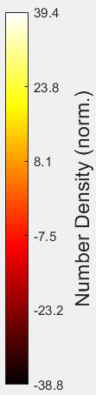
4. 3D Density Field of Frame 36
3D field created by stacking the 2D cross-section images
Iso view
Top view
Side view
Plasma expands more horizontally than vertically
-38.8 -23.2 -7.5 8.1 23.8 39.4

Slide 11
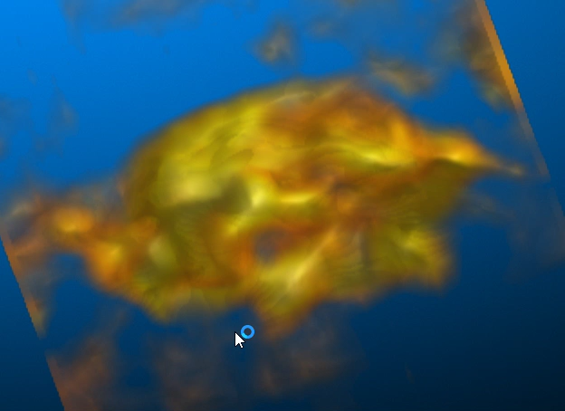
Conclusions
Plasma field is asymmetric
Irregular and nonuniform
  Frame shift in Schlieren images
  Lack of angles and transform artefacts
Future Work
Support Mach 5 wind tunnel campaign with a LAFPA to control SBLI
Optimize phase averaging
Collect more viewing angles

Slide 12
Acknowledgments
Thank you to Dr. James Threadgill, Ashish Singh, and Chris Mason for your guidance and assistance during this process.
Thank you to the funding agency, NASA, for supporting important student research internships.
Supported in part through the Arizona NASA Space Grant Consortium, Cooperative Agreement 80NSSC25M7084.

Slide 13
THANK YOU!!
sbayliff@arizona.edu

